Slide 1
Federated Learning for Selective State-Space Models
ECE 60131: Inference & Learning in Generative Models
Adam Piaseczny

Slide 2

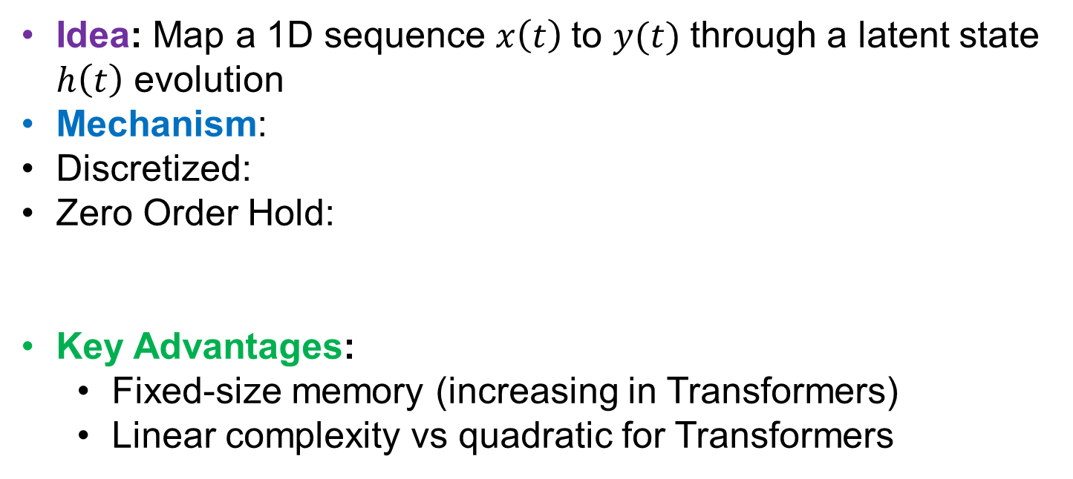
Default State Space Models (SSMs)
Idea: Map a 1D sequence $x\left(t\right)$to $y(t)$ through a latent state $h\left(t\right)$ evolution
Mechanism:
Discretized:
Zero Order Hold:
Key Advantages:
Fixed-size memory (increasing in Transformers)
Linear complexity vs quadratic for Transformers
$$y\left(t\right)=Ch\left(t\right)+Dx\left(t\right) { h}^{′}\left(t\right)=Ah\left(t\right)+Bx(t)$$
$$y_{t}=Ch_{t}+Dx_{t} { h}_{t}=\overline{A}h_{t−1}+\overline{B}x_{t}$$
$$\overline{A}=\exp{(ΔA}), \overline{B}={\left(ΔA\right)}^{−1}(\exp\left(ΔA\right)−I)ΔB$$
Grootendorst, M. (2024, February 21). A visual guide to Mamba and state space models. Maarten Grootendorst's Newsletter. https://newsletter.maartengrootendorst.com/p/a-visual-guide-to-mamba-and-state

Slide 3
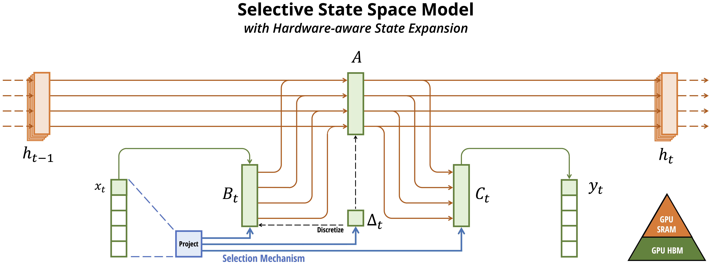
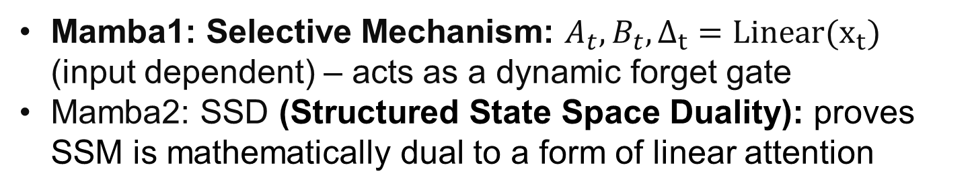
Selective SSMs: Mamba & Mamba2
Mamba1: Selective Mechanism: $A_{t},B_{t},Δ_{t}=Linear(x_{t})$ (input dependent) – acts as a dynamic forget gate
Mamba2: SSD (Structured State Space Duality): proves SSM is mathematically dual to a form of linear attention
Mamba: Linear-Time Sequence Modeling with Selective State Spaces Albert Gu*, Tri Dao*

Slide 4

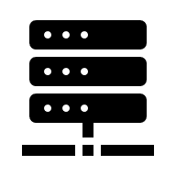
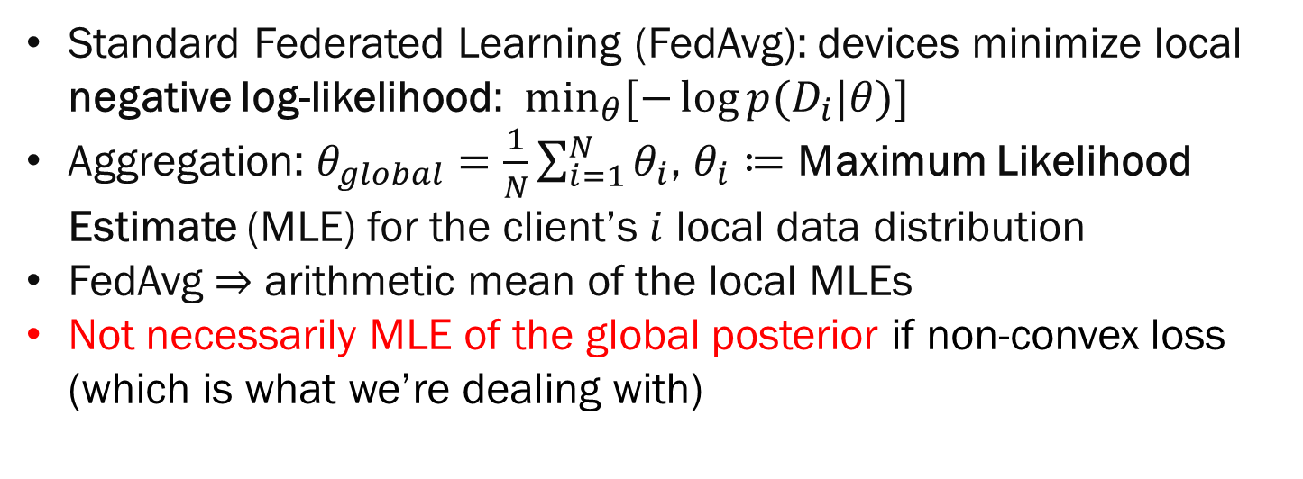
Federated Learning as Maximum Likelihood Estimation
Standard Federated Learning (FedAvg): devices minimize local negative log-likelihood: $\min_{θ}{[−\log{p(D_{i}|θ)}]}$
Aggregation: $θ_{global}=\frac{1}{N}\sum_{i=1}^{N}{θ_{i}}$, $θ_{i}≔$ Maximum Likelihood Estimate (MLE) for the client’s $i$ local data distribution
FedAvg $⇒$ arithmetic mean of the local MLEs
Not necessarily MLE of the global posterior if non-convex loss (which is what we’re dealing with)

Slide 5
Project Idea
Mamba relies state dynamics to maintain memory.
Linear averaging could potentially interfere with the learned dynamics
Project Goal:
Analyze performance of FedAvg with Mamba2
Test other aggregation frameworks to see if I can improve

Slide 6
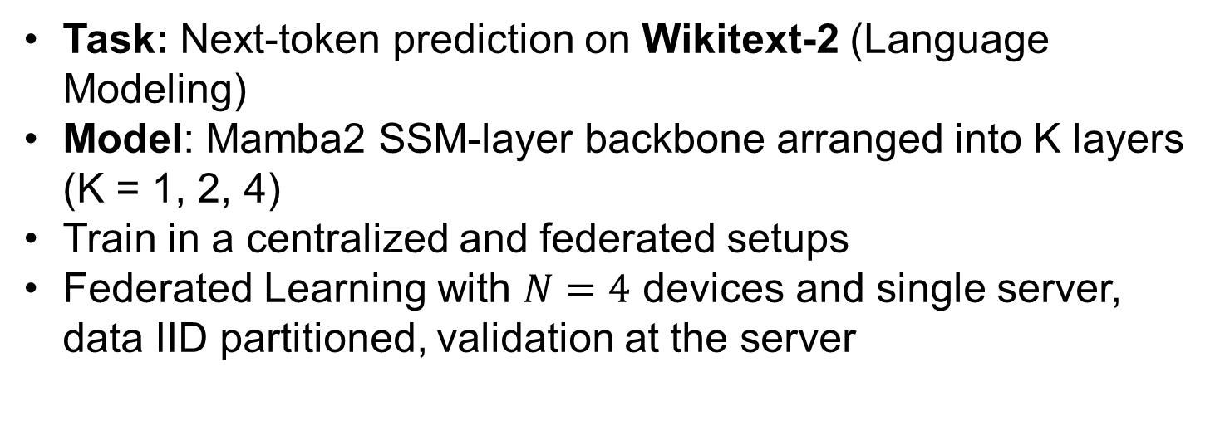
Methodology
Task: Next-token prediction on Wikitext-2 (Language Modeling)
Model: Mamba2 SSM-layer backbone arranged into K layers (K = 1, 2, 4)
Train in a centralized and federated setups
Federated Learning with $N=4$ devices and single server, data IID partitioned, validation at the server
{
"step": 580,
"val_loss": 5.535672484851275,
"val_ppl": 253.57825784836297,
"train_loss": 4.783262252807617,
"generated": "Once upon a time,, and was the first to be a result of the first two @-@ year @-@ old, and the player's second @-@ highest @-@ day run. The game was released on October 22, 2013. \n = = = = = = = \n The game was the first to be released on the album, and was released on November 12, 2013. The album was released on November 22, 2013. The album was released on November 22, 2013.", }
}

Slide 7
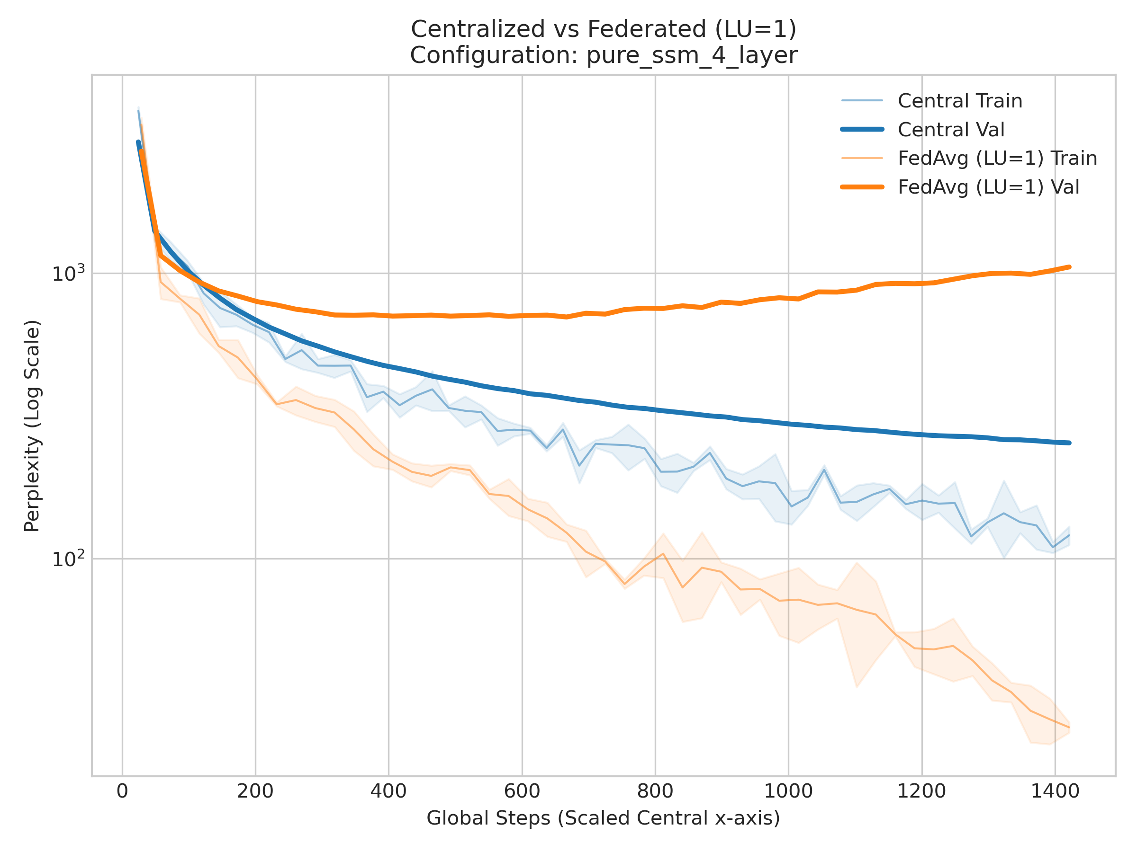
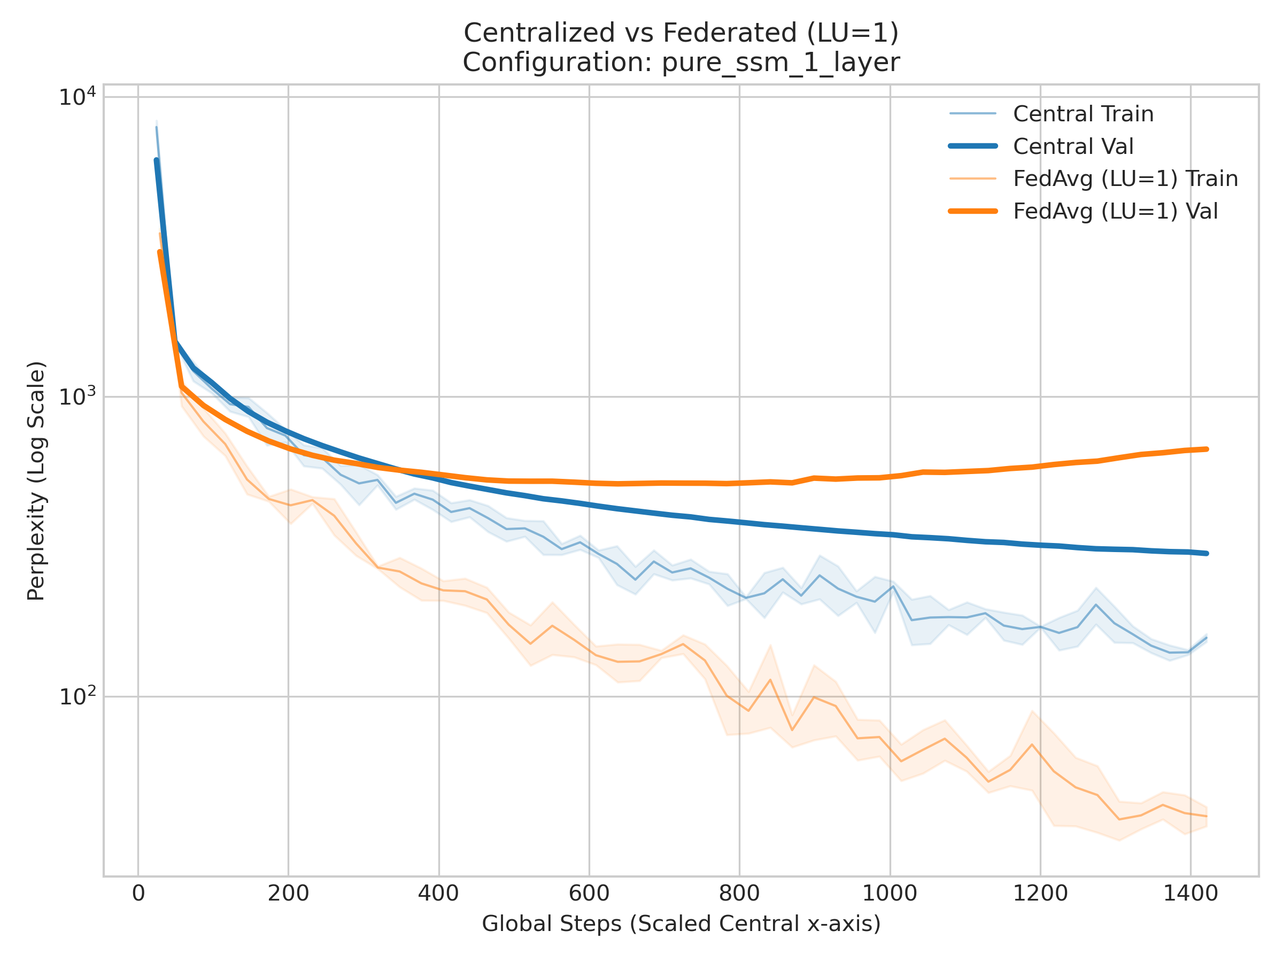
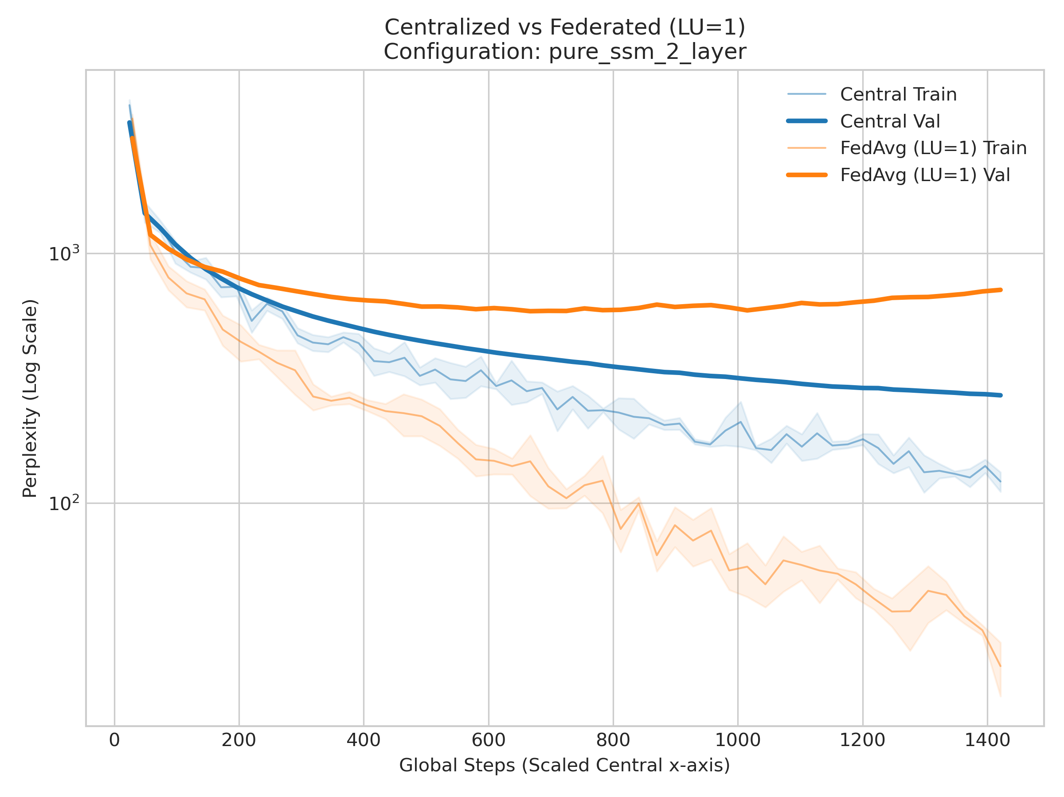
Results: FedAvg vs Centralized
Performance gap in validation perplexities
FedAvg seems to overfit fast. It never reaches as good performance and deteriorates over time

Slide 8
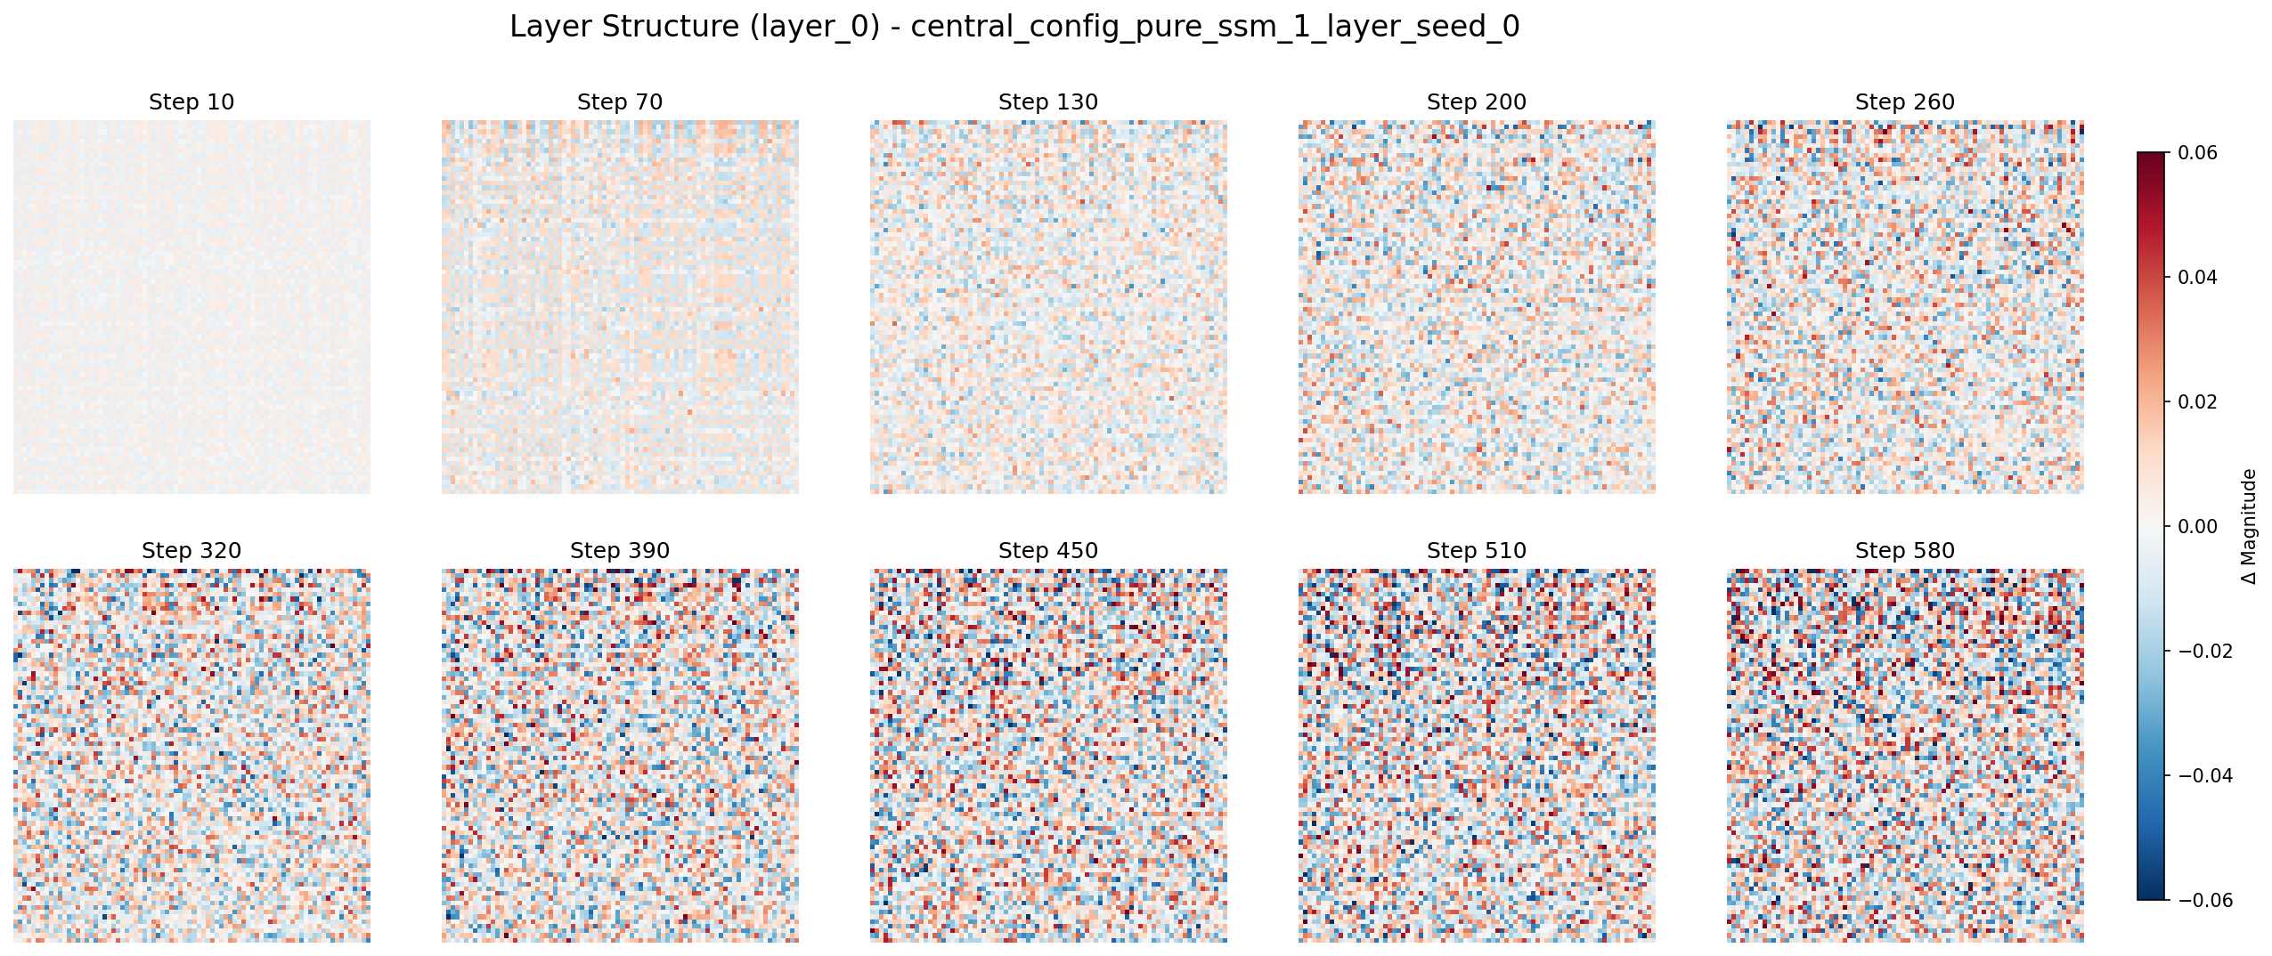
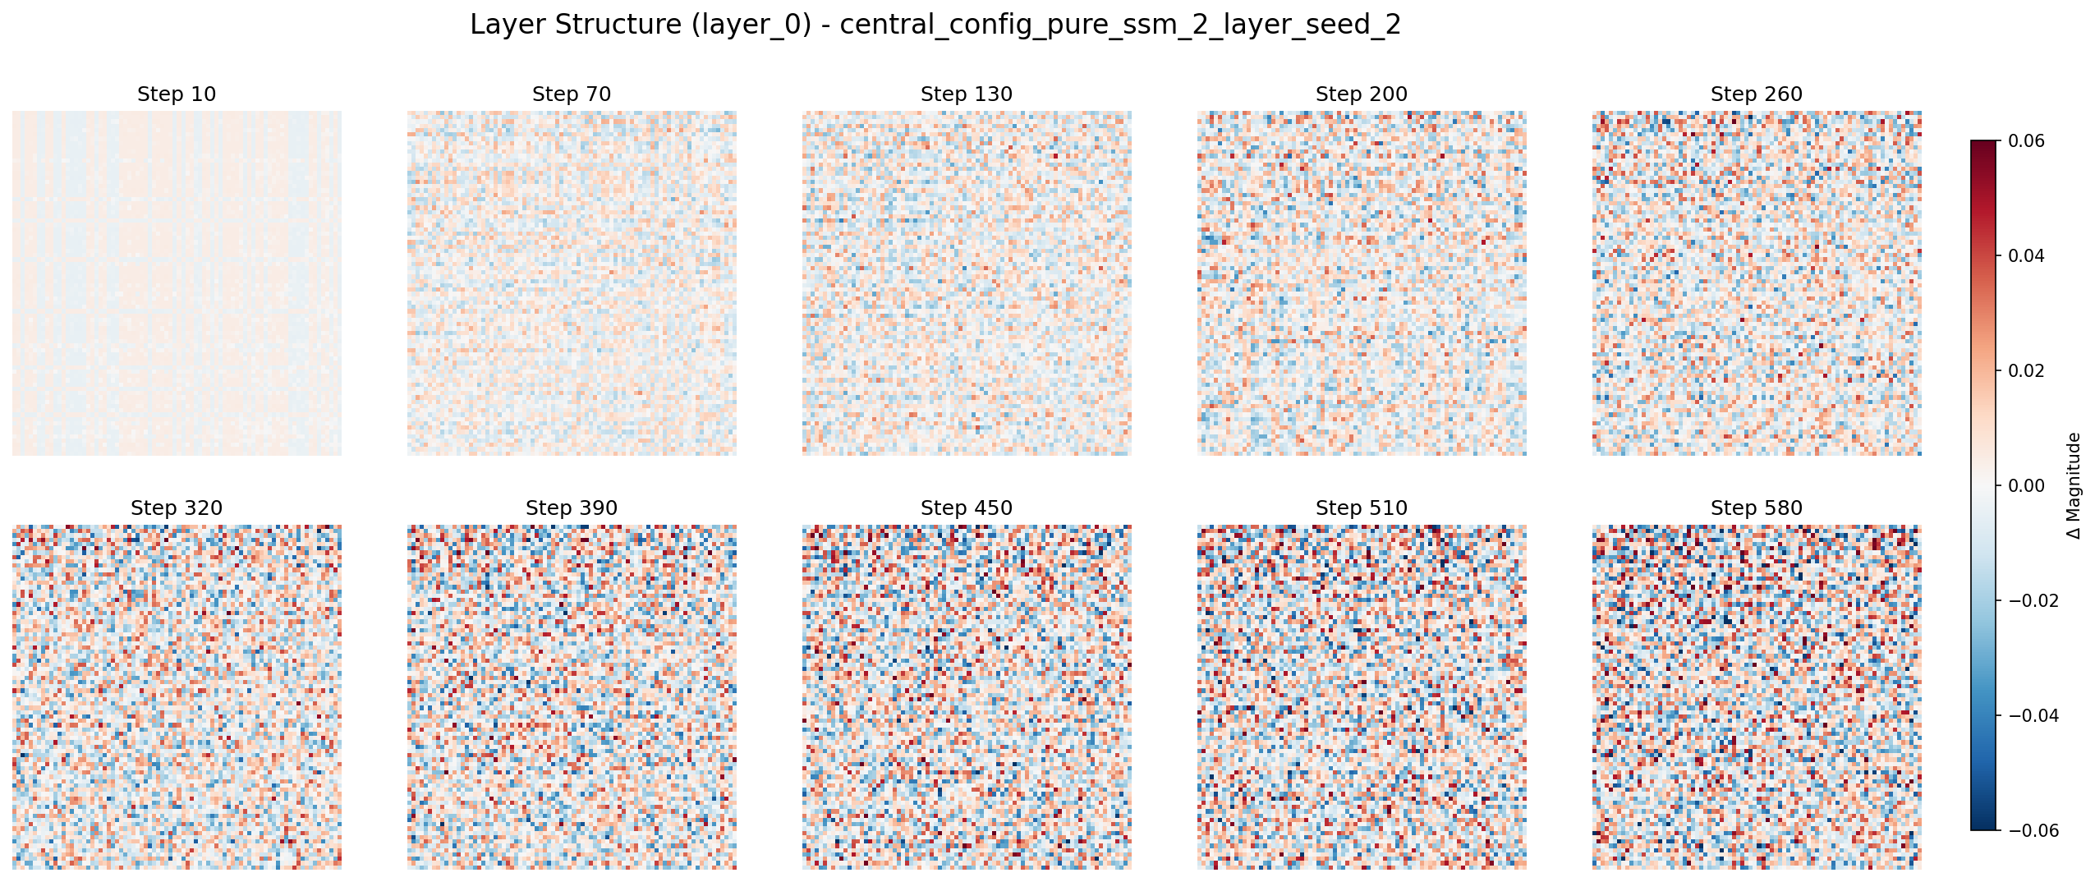
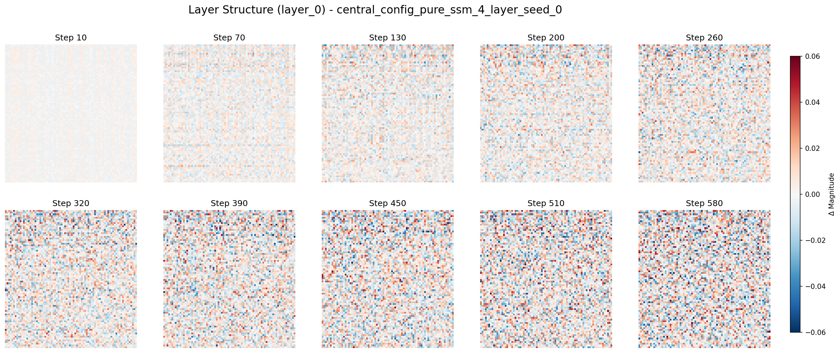
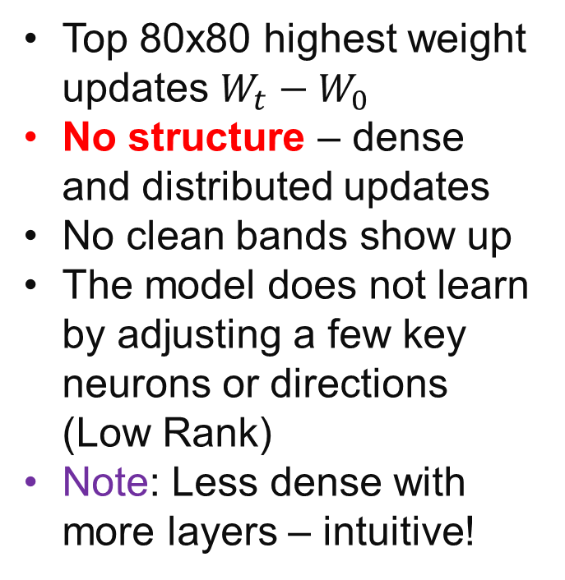
Results: Dense Learning
Top 80x80 highest weight updates $W_{t}−W_{0}$
No structure – dense and distributed updates
No clean bands show up
The model does not learn by adjusting a few key neurons or directions (Low Rank)
Note: Less dense with more layers – intuitive!

Slide 9
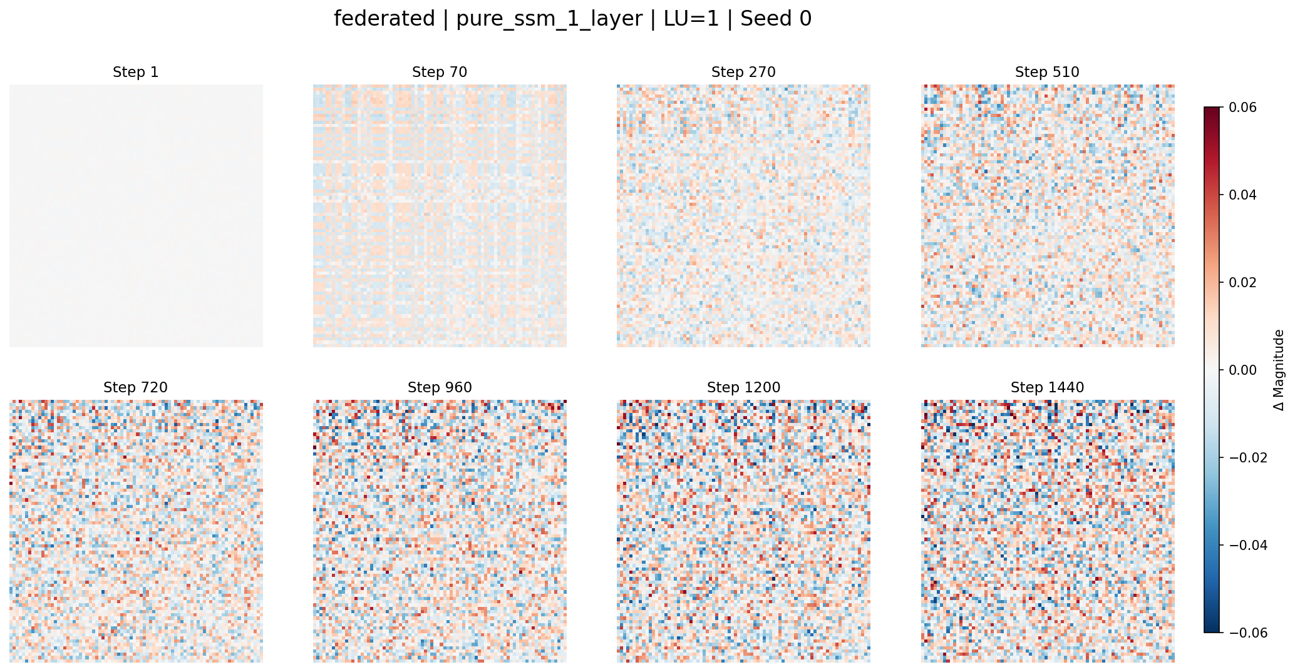
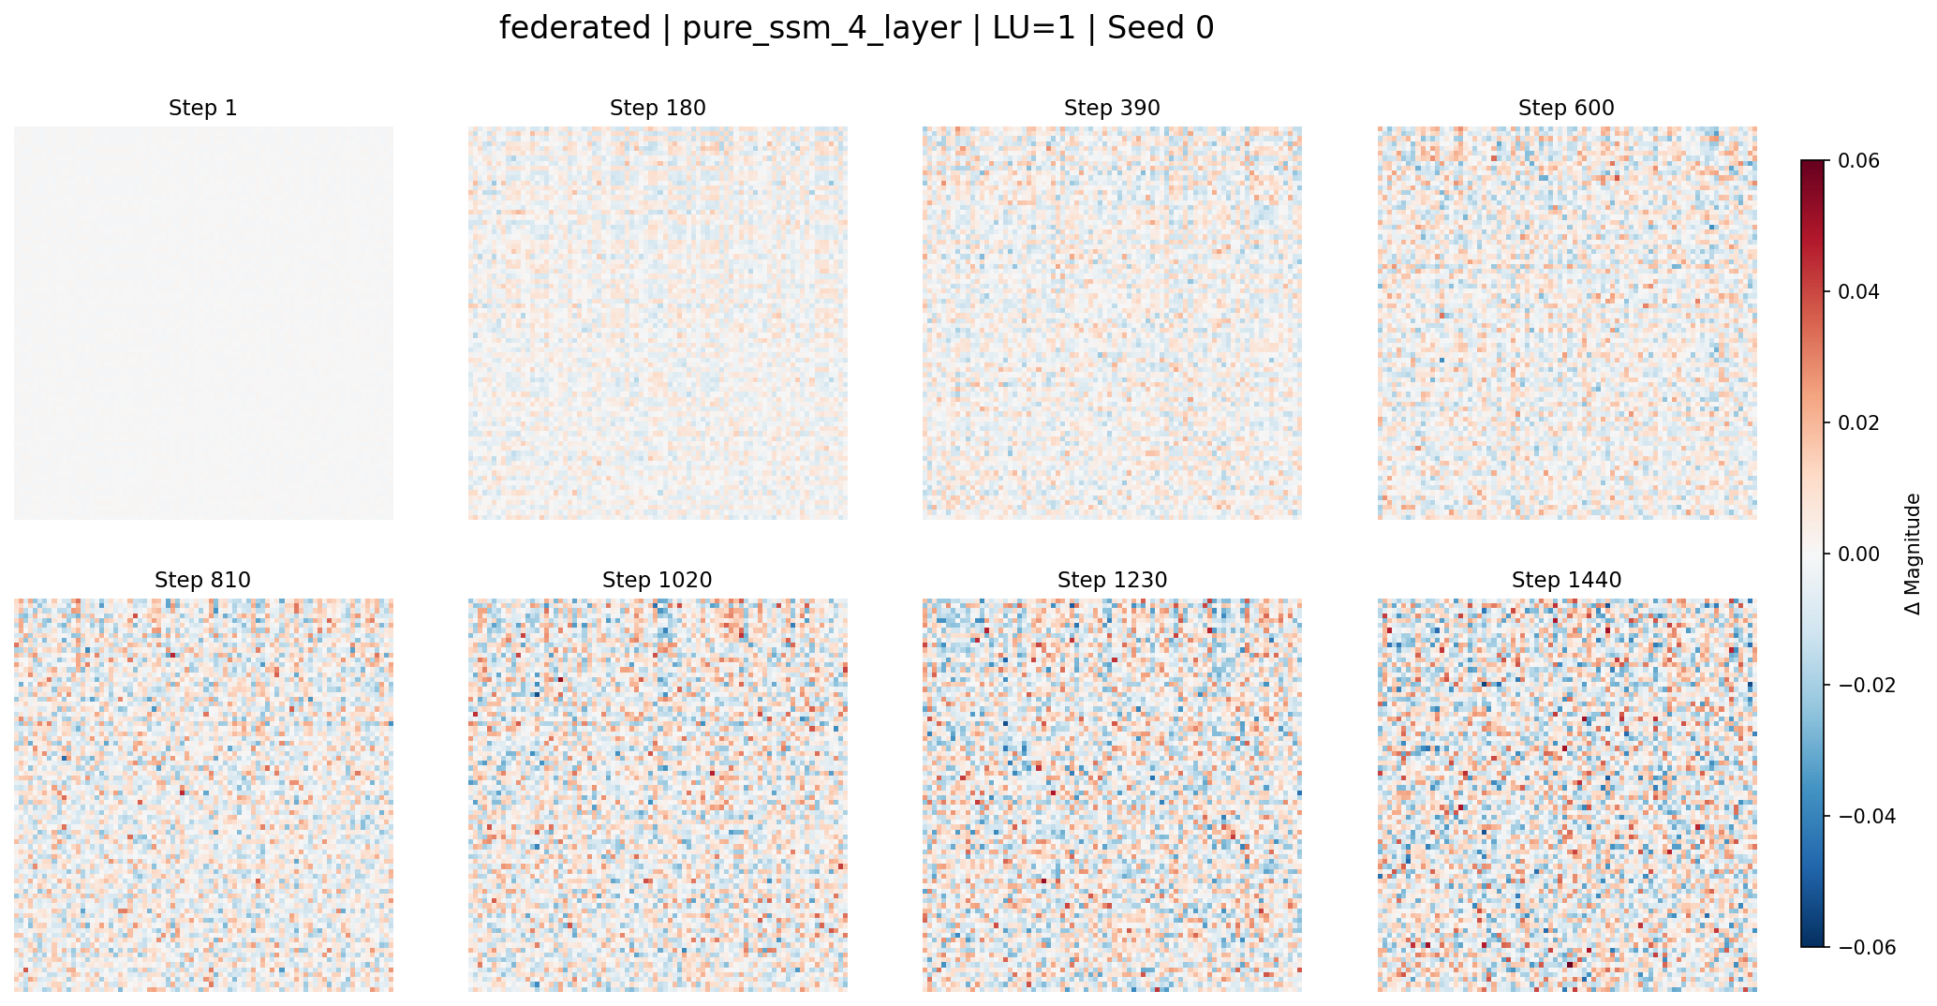
Results: Dense Learning in FL
Similar behavior in Federated Learning
Note: less variance compared to centralized
Not learning as fast
Even more evident for a deeper model
9

Slide 10
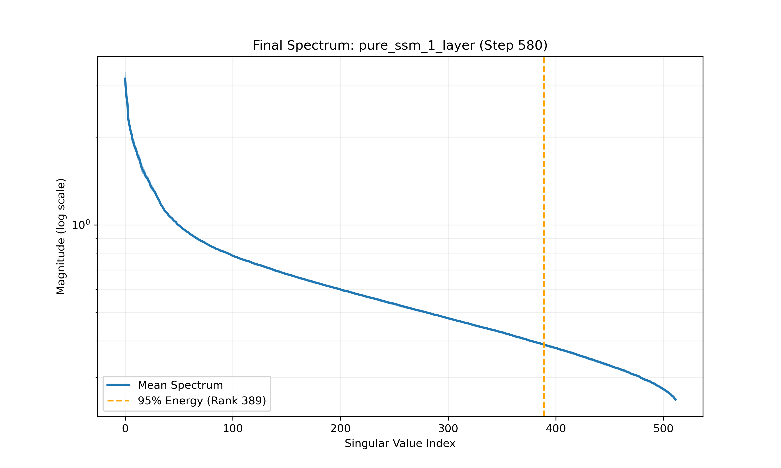
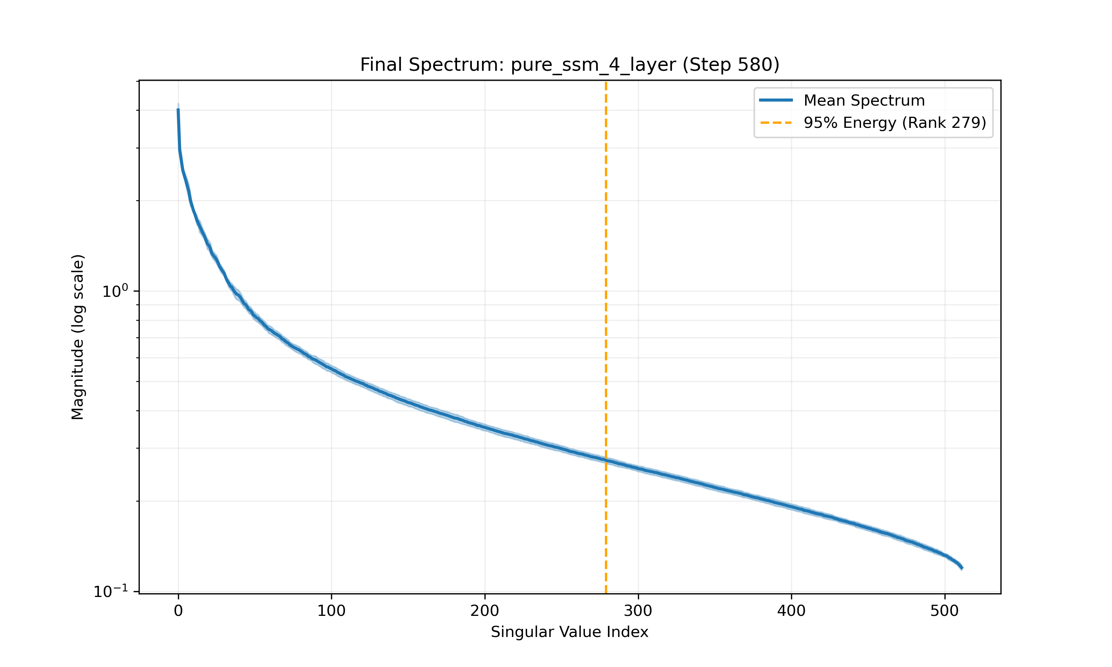
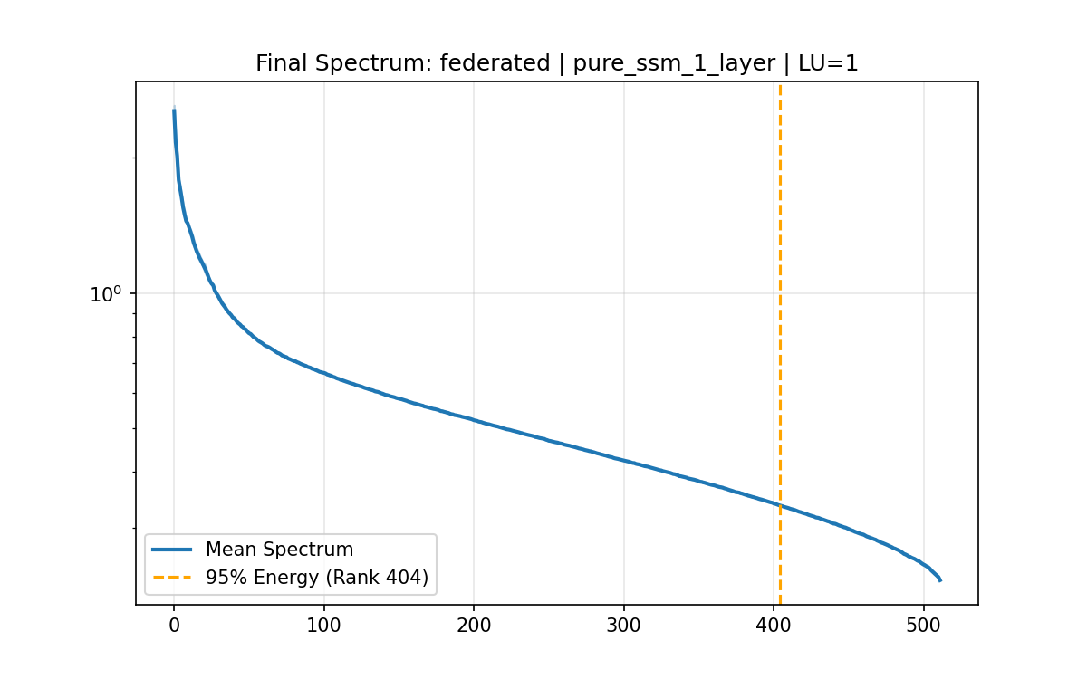
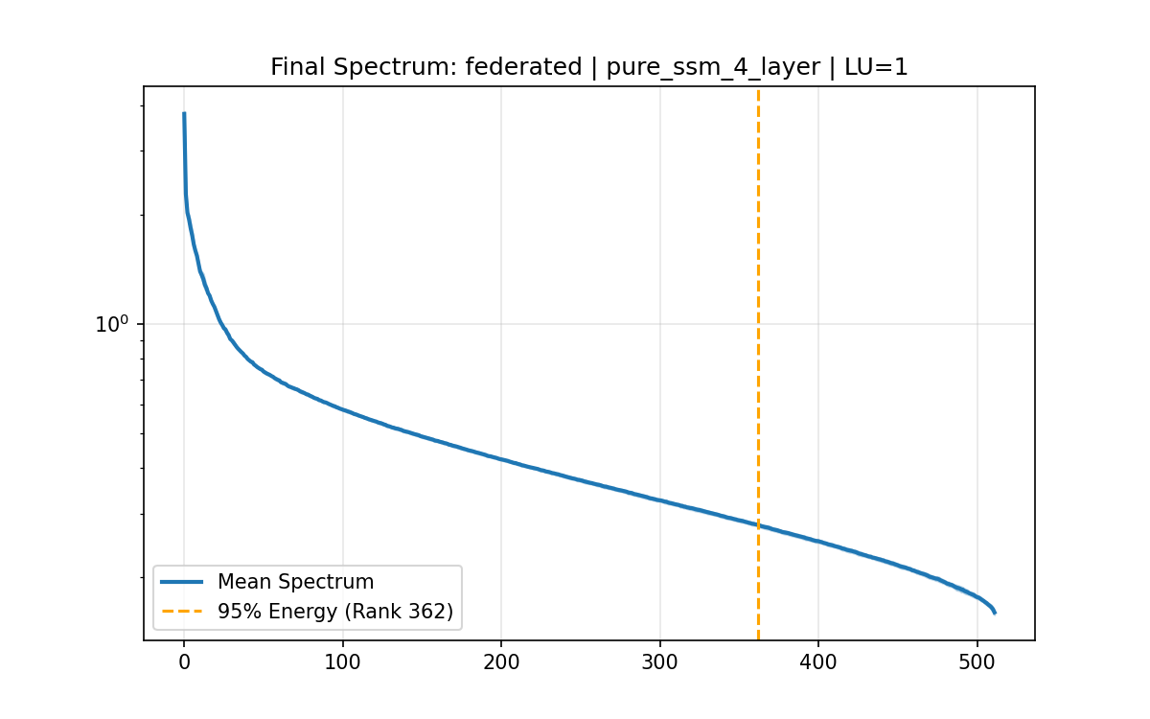
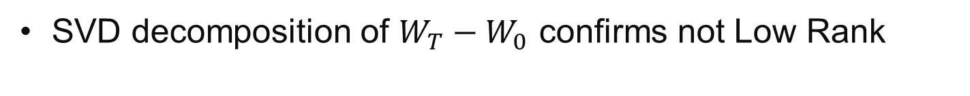
Results: SVD Decomposition
SVD decomposition of $W_{T}−W_{0}$ confirms not Low Rank

Slide 11
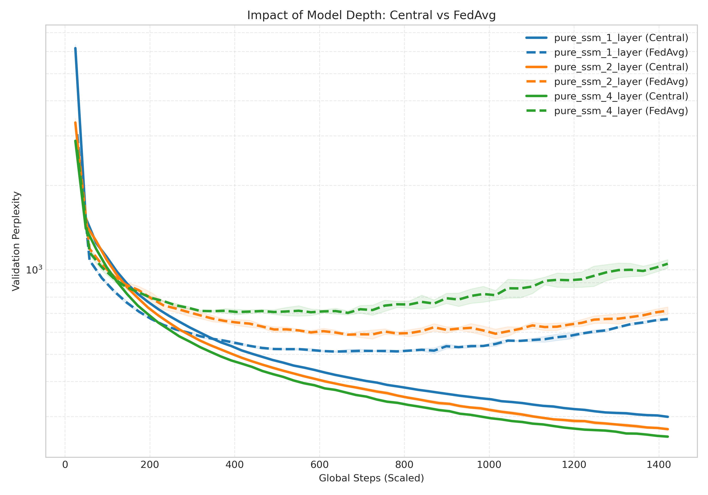
Results: Model Depth Effect
Deeper centralized models lead to lower validation perplexity
Opposite effect for FedAvg – averaging deeper models might be destructive to model dynamics (or could be overfitting)

Slide 12
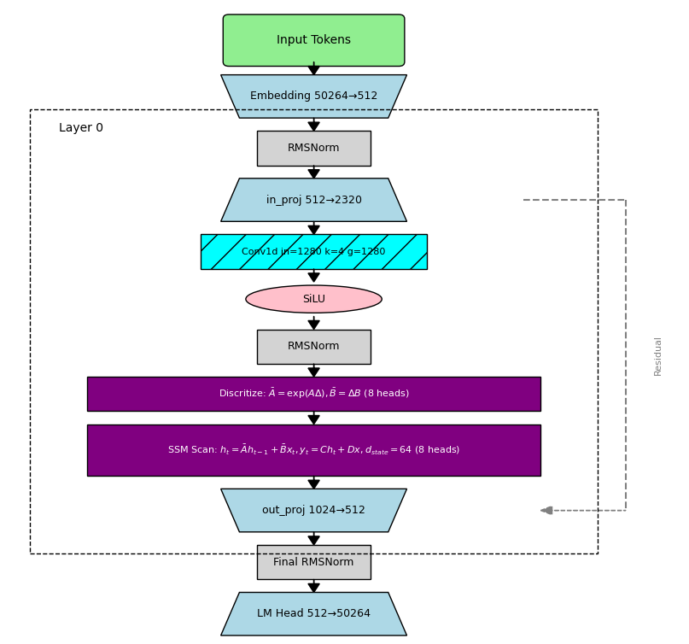
Improvement Ideas
How to improve over FedAvg (simple arithmetic averaging of the MLE)
For this project: incorporate methods from bayesian inference and signal processing
3 proposed modifications:
FedFisher: precision-weighted aggregation
FedEntropy: confidence-weighted aggregation
FedMomentum: server-side smoothing

Slide 13
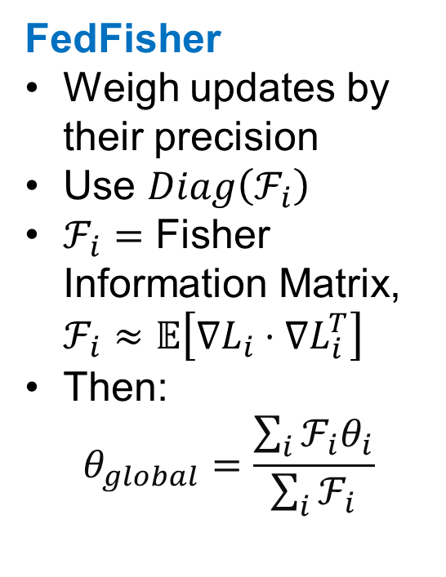
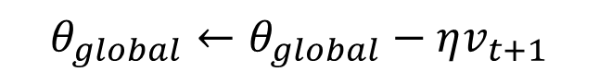
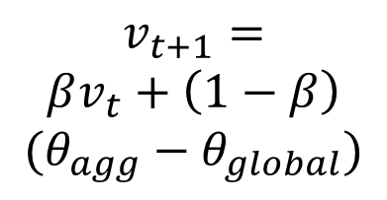

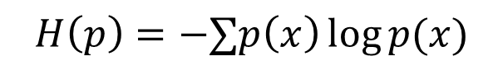
Proposed Aggregation Modifications
FedFisher
Weigh updates by their precision
Use $Diag\left(ℱ_{i}\right)$
$ℱ_{i}=$ Fisher Information Matrix, $ℱ_{i}≈𝔼\left[∇L_{i}⋅∇L_{i}^{T}\right]$
Then:
$$θ_{global}=\frac{\sum_{i}{ℱ_{i}θ_{i}}}{\sum_{i}{ℱ_{i}}}$$
FedEntropy
Weigh updates by their confidence
Use:
with a device-local validation set
Aggregation weights:
FedMomentum
Treat updates as a noisy signal of a “true” gradient trajectory
Apply momentum at server
$$H\left(p\right)=−∑p\left(x\right)\log{p(x)}$$
$$v_{t+1}=$$
$$βv_{t}+\left(1−β\right)$$
$$(θ_{agg}−θ_{global})$$
$$w_{i}=\frac{e^{−H_{i}}}{\sum_{j}{e^{−H_{j}}}}$$
$$θ_{global}←θ_{global}−ηv_{t+1}$$
Notes:
FedFisher: Trust the client that learned a 'sharp' feature (high curvature/fisher) more than the client that learned nothing (flat/low fisher).
FFedEntropy: Clients who are "confused" (high entropy) are down-weighted. This filters out noise and prevents "catastrophic forgetting" of clear patterns.

Slide 14
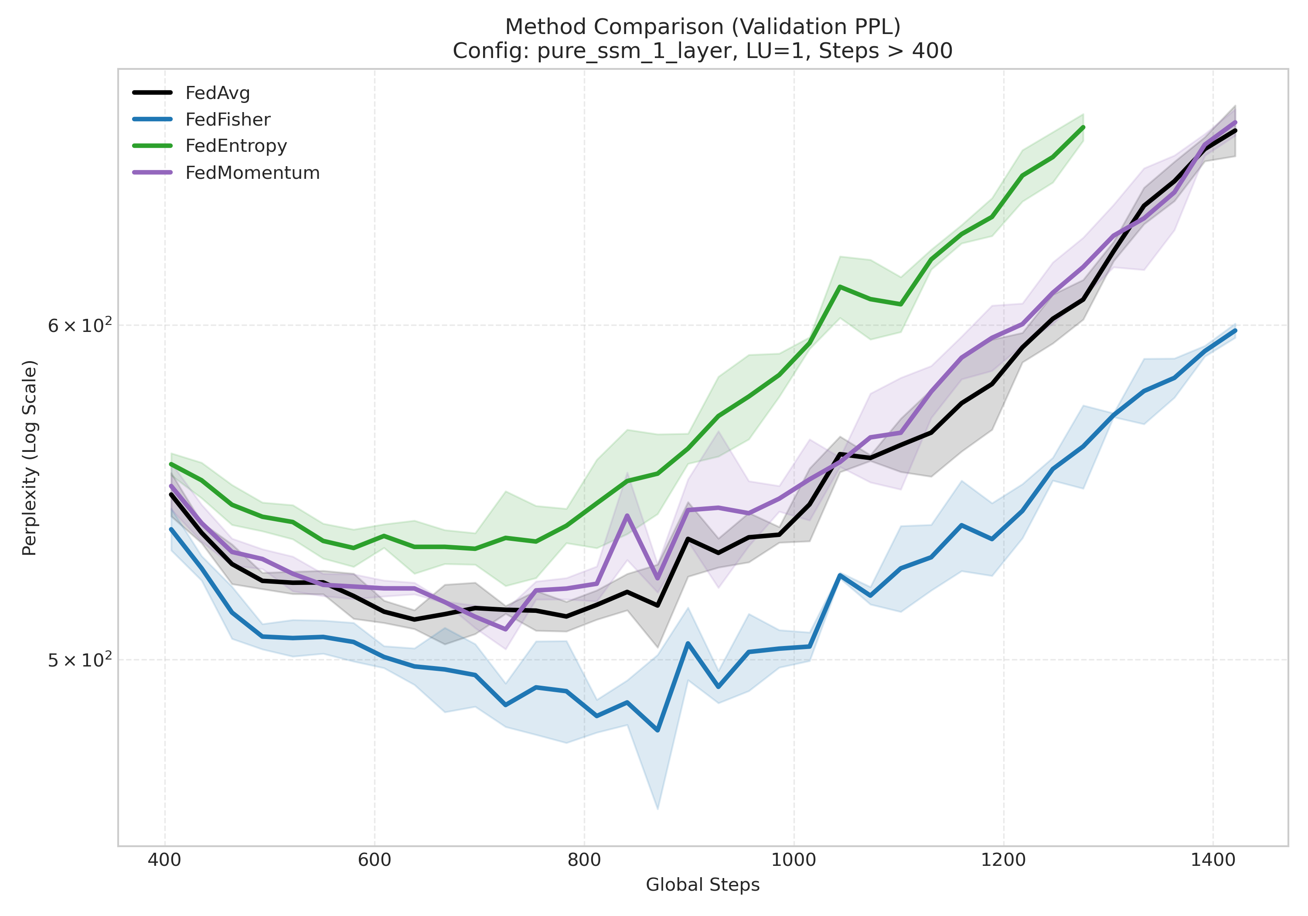
Results: New Aggregation Methods
FedFisher outperforms all others, including FedAvg!
Best achieved perplexity and least overfitting
FedEntropy performed worst
Conclusion: able to outperform arithmetic MLE mean
Notes:
This suggests that weighting by the Fisher Information acts as a powerful Bayesian Regularizer.
By down-weighting parameters with low curvature (which are likely noise) and emphasizing parameters with high curvature (structural features),
we prevent the global model from drifting into sharp, non-generalizable minima.
It is likely that clients with the lowest entropy were simply overfitting their local data the hardest.
By weighting them higher, we actually polluted the global model with their local biases.

Slide 15
Thank You!

